Slide 1

BRAND BASICS:
WHY SHOULD WE CARE, AND WHAT SHOULD WE DO?
April 10, 2024
Notes:
My name is Nancy Peterson, I’m a member of Rotary Club of Kalamazoo and I’m club secretary and District Public Imge Chair. Today, we’ll talk about what branding is, why it matters, and the value of brand consistency

Slide 2

Branding and Brand
Consistency
Notes:
Some brands are recognized around the world just by their logos. When people see the logo, they instantly know what it means and what to expect from the product.
Building that kind of visual recognition requires effort, including years of using a logo widely and consistently. Companies work at this because earning that global recognition benefits their business.
Rotary is no different because we want the public and other organizations to know who we are and what we stand for.
We can deliver that message to the world if we are consistent with our brand and logos.

Slide 3
WHY DO WE NEED BRANDING?
It exposes people to:
Our core messages
Our visual identity
Our core values
What to expect from Rotary

Slide 4
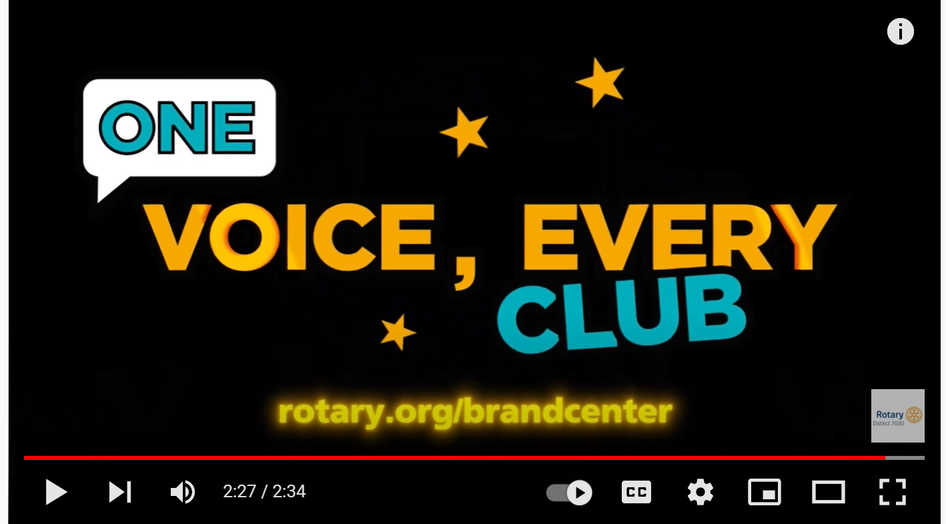
LET’S LEARN A LITTLE MORE ABOUT ROTARY LOGOS

Slide 5

It’s delivering messages that always align with:
Our brand identity
Our values
Our organizational strategy
WHAT IS BRAND CONSISTENCY?
Notes:
Rotary benefits from having a strong, recognizable brand.
When people see our logos in print, online, or on social media, they should immediately recognize them as representing both Rotary and our values.
You can strengthen Rotary not just in your community but all over the world by using our logos correctly and consistently, which reinforces to the public who we are.
We want people outside Rotary to recognize our brand as representing a trusted organization and understand what our values are: fellowship, integrity, diversity, service, and leadership.
By talking about these values and showing what we do in a positive way, we can reinforce our brand and our messages.
Being consistent with our branding also means we represent ourselves professionally.

Slide 6

Notes:
It’s important to understand that Rotary’s strategy underpins our messaging.
We know our Action Plan should guide us when we think about writing an article, posting on social media, communicating about a project, or promoting an event.

Slide 7
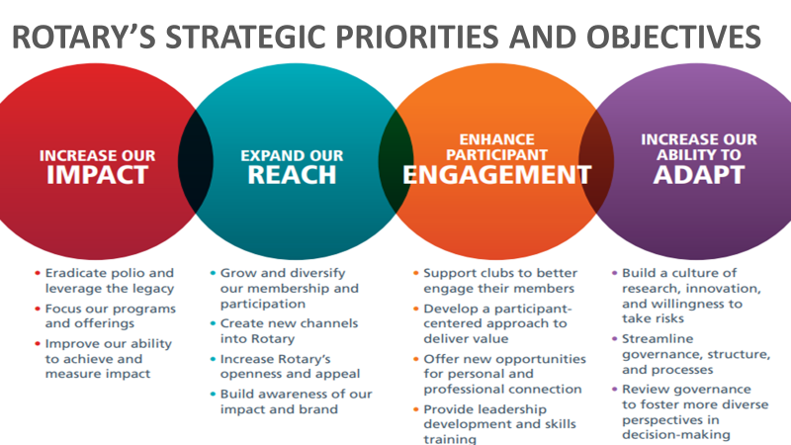
Notes:
We can always be thinking about how a message or an action will help us reach an objective or fulfill a priority.
When we know what we want to achieve, then we can consider how to get a consistent message and look across all our channels.

Slide 8
Notes:
A great opportunity to reinforce Rotary’s brand is to be at a public event. Large format graphics have good impact.

Slide 9

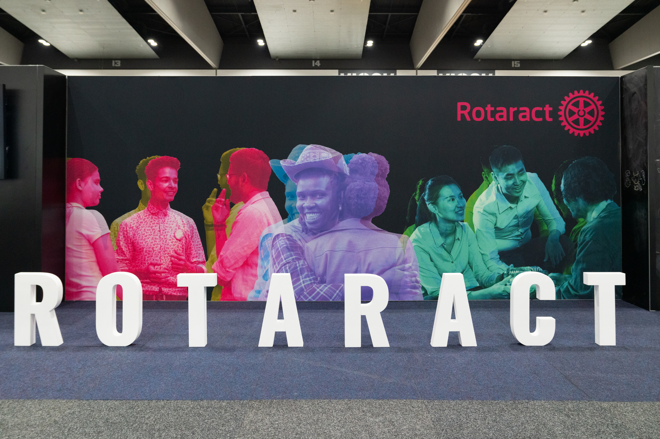
CORRECT BRANDING
Notes:
A great opportunity to reinforce Rotary’s brand is to be at a public event.

Slide 11
STEPS TO BEING A BRAND CHAMPION
Take the “Our Logo: Representing Rotary” course.
Use the Brand Center to create your club logo.
Assess all your club materials to make sure they adhere to Rotary’s brand guidelines.
Make sure that you and your club’s members are representing our brand in the hats and shirts you wear and the materials you hand out.
Notes:
How can you start? The beginning is understanding our brand and how we use different elements of our brand.
You have a lot of resources available to help with this.
First, take the “Our Logo: Representing Rotary” course in the Learning Center.
Next, make your club logo using a template from the Brand Center. Download it in the formats you’ll need and save it where you can easily find it.
Then, encourage your club officers and public image team to assess all your club materials such as promotional items, banners, email headers, and more and update them if necessary.
And of course, we all represent the Rotary brand. Remember that when we’re out in our communities, we need to have the correct branding on our shirts, hats, and vests.
We don’t do what we do for the recognition — but we want people to understand who we are and what we do when they encounter our brand.

Slide 12

What is Rotary?
Rotary is a global network of 1.4 million neighbors, friends, leaders, and problem-solvers who see a world where people unite and take action to create lasting change – across the globe, in our communities, and in ourselves.
Notes:
So, one of our objectives is to increase awareness and understanding of Rotary around the world.
How do we do that? How do we help people perceive Rotary the way we do?
We can start by highlighting the impact that clubs and members are making in their communities and presenting Rotary in a consistent and compelling way to those who don’t know us. No one understands the benefits of Rotary better than our members. That‘s why we rely on our more than 1.4 million members to share their stories with the public.

Slide 13
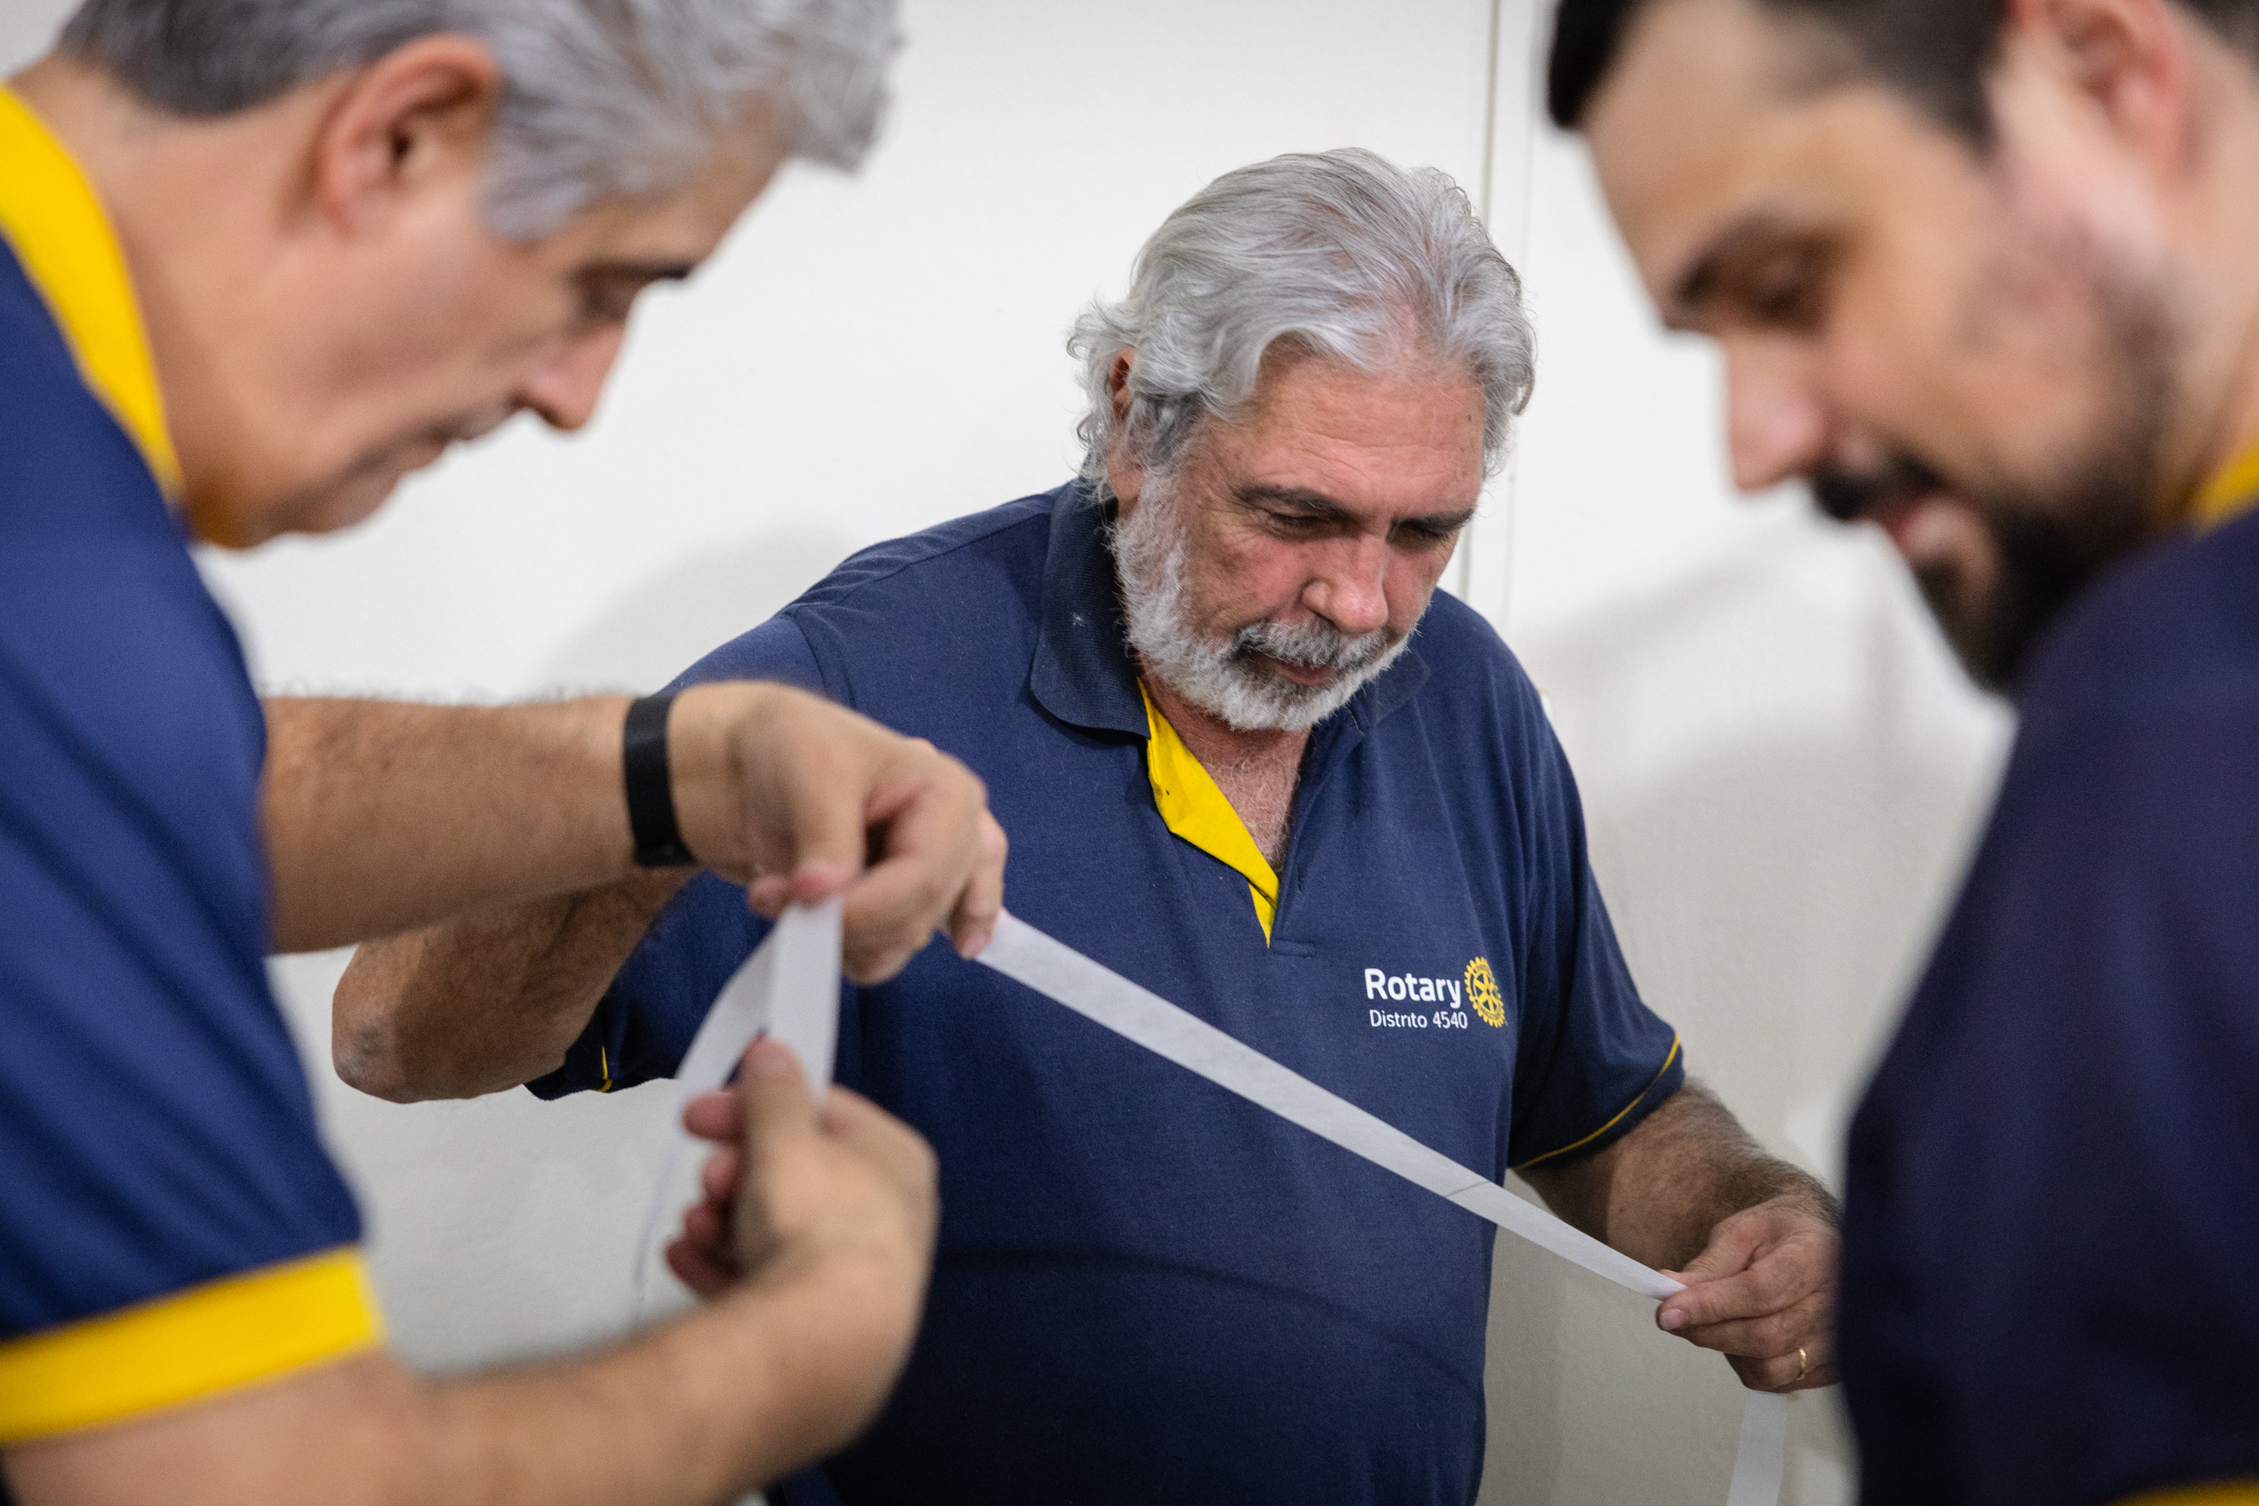
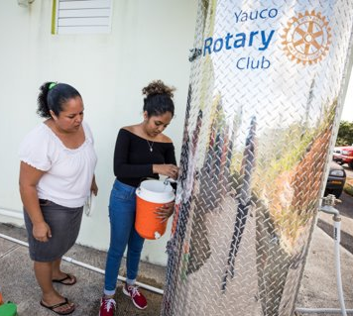
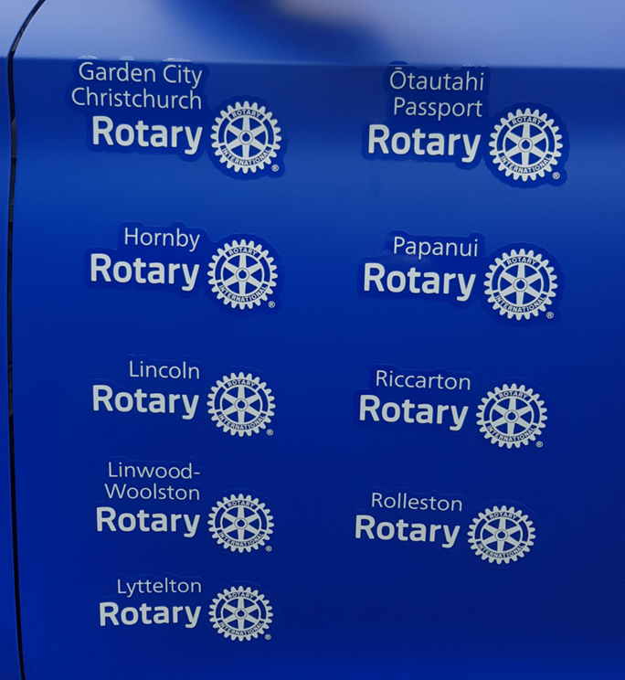
USE OF CLUB LOGOS
Notes:
To help you understand how to use Rotary's brand correctly, here are some examples of clubs using their logos on shirts and marketing materials.

Slide 14





INCORRECT BRANDING
Notes:
A key part of brand consistency is using the same correct logos across all our promotional materials.
In these examples, the image on the left uses an outdated logo. The logo on the right is the updated and correct form.

Slide 15












INCORRECT USAGE
Notes:
See what happens when our members take creative liberty with our logo. It’s all over the place. The use of various colors, fonts, and sizes, along with the alteration of the Mark of Excellence illustrates no cohesion or unity. Perhaps all of these programs are part of a larger network, but it’s really hard to tell. And that can cause a potential member, donor, or partner to doubt if we are an organization they can trust –- to join, to donate money to, or partner with.
Logo usage rules allow us to share a consistent story and message.

Slide 16

How many branding mistakes can you spot?

Slide 17

How many branding mistakes can you spot?
Always use your club identifier
In naming events, fundraisers use your club name
Don’t use the Mark of Excellence as a replacement for letters, numbers or to replace a wheel
Don’t change the color of the Rotary logo
The yearly theme is only for internal communications
Don’t use the legacy “old” Rotary Wheel
Don’t change the opacity, watermark, cut off any part of the Mark of Excellence or put text or images over the Mark of Excellence or Masterbrand Signature
Lockups are only used to partner, event, program, or sponsor’s logo or name to show your club’s affiliation with the other entity, not for a tag line

Slide 18
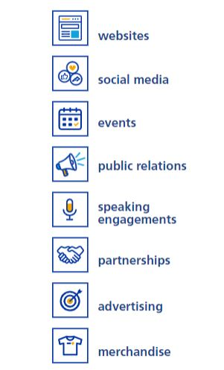
HOW to Promote rotary
Notes:
You have lots of ways to communicate Rotary’s impact, including your club website, social media, events, partnerships, and more.
All of them can be effective, but especially so when they build upon each other.
Telling stories of local impact consistently across several communication channels will help build Rotary’s public image.

Slide 19

Public Image Coaching: Sample Social Media Monthly Calendar
These are just a sample of some things your club or district can promote or post on social media. Choose your frequency of how often you post, but we recommend no less than once per week. For this sample, the regular meeting is held each Tuesday with a special event on the last Friday of the month.
Sunday | Monday | Tuesday | Wednesday | Thursday | Friday | Saturday
1 Invite to “like” us | 2 Join us tomorrow as we welcome speaker…. | 3 Photo from the meeting w/ caption Members “check in” at meeting. | 4 Featured member photo & why they love Rotary | 5. Throwback Thursday photo from older project or retired members | 6 Foundation Friday focus on 1 of the 6 Areas of Focus | 7 Link to new content on club’s website
8 Shout out to another club with link | 9 We can’t wait for our meeting tomorrow… | 10 Photo from the meeting w/ caption Members “check in” at meeting. | 11 Event promo | 12 Interested in joining Rotary? Join us on Tuesdays at noon at… | 13 Foundation Friday focus on Rotary partners worldwide | 14 Meet our newest member...
15 Change cover photo | 16 Join us tomorrow as we welcome speaker…. | 17 Photo from the meeting w/ caption Members “check in” at meeting. | 18 Link to District news story | 19 Throwback Thursday photo from older project or retired members | 20 Foundation Friday focus on 1 of the 6 Areas of Focus | 21 Event promo
22 Change profile photo | 23 Interested in joining us tomorrow for lunch? Our speaker is... | 24 Photo from the meeting w/ caption Members “check in” at meeting. | 25 Event reminder | 26 Curious about what we do? Check out our website... | 27 Today’s the day for our event… | 28 Upload photo album from event and tag photos
29 Thank you to event sponsors | 30 Thank you to event attendees and results | 31 Photo from the meeting w/ caption Members “check in” at meeting.
Questions? Contact us:
rotary7930publicimage@yahoo.com
Shared at Zone 28 & 32 Learning to Lead, Toronto, ON | Sep 2023

Slide 20
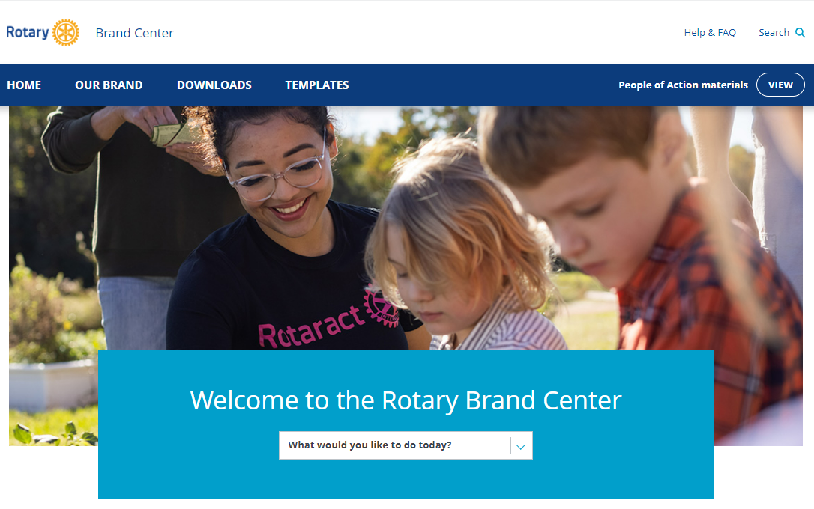
WHAT you can do today
  Use the Brand Center resources
  Always use the correct branding
  Show your club in action
  Invite public participation
  Use content from Rotary International
  Appoint a public image chair
Show people outside Rotary that we are people of action.
Notes:
You can be an ambassador who shows the world that Rotary members are people of action!

Slide 21
Consistency is key
Share your logo with your club members.
Make sure your partners use it for any events you host together.
Review your website and social media accounts and update the branding wherever it’s needed.
Make sure your event posters and advertising material have up-to-date logos and branding.
Use the guidelines in the Brand Center to build a club collection of People of Action images
Notes:
Here are more ways to ensure brand consistency.

Slide 22


Use district and club logos correctly

Slide 23
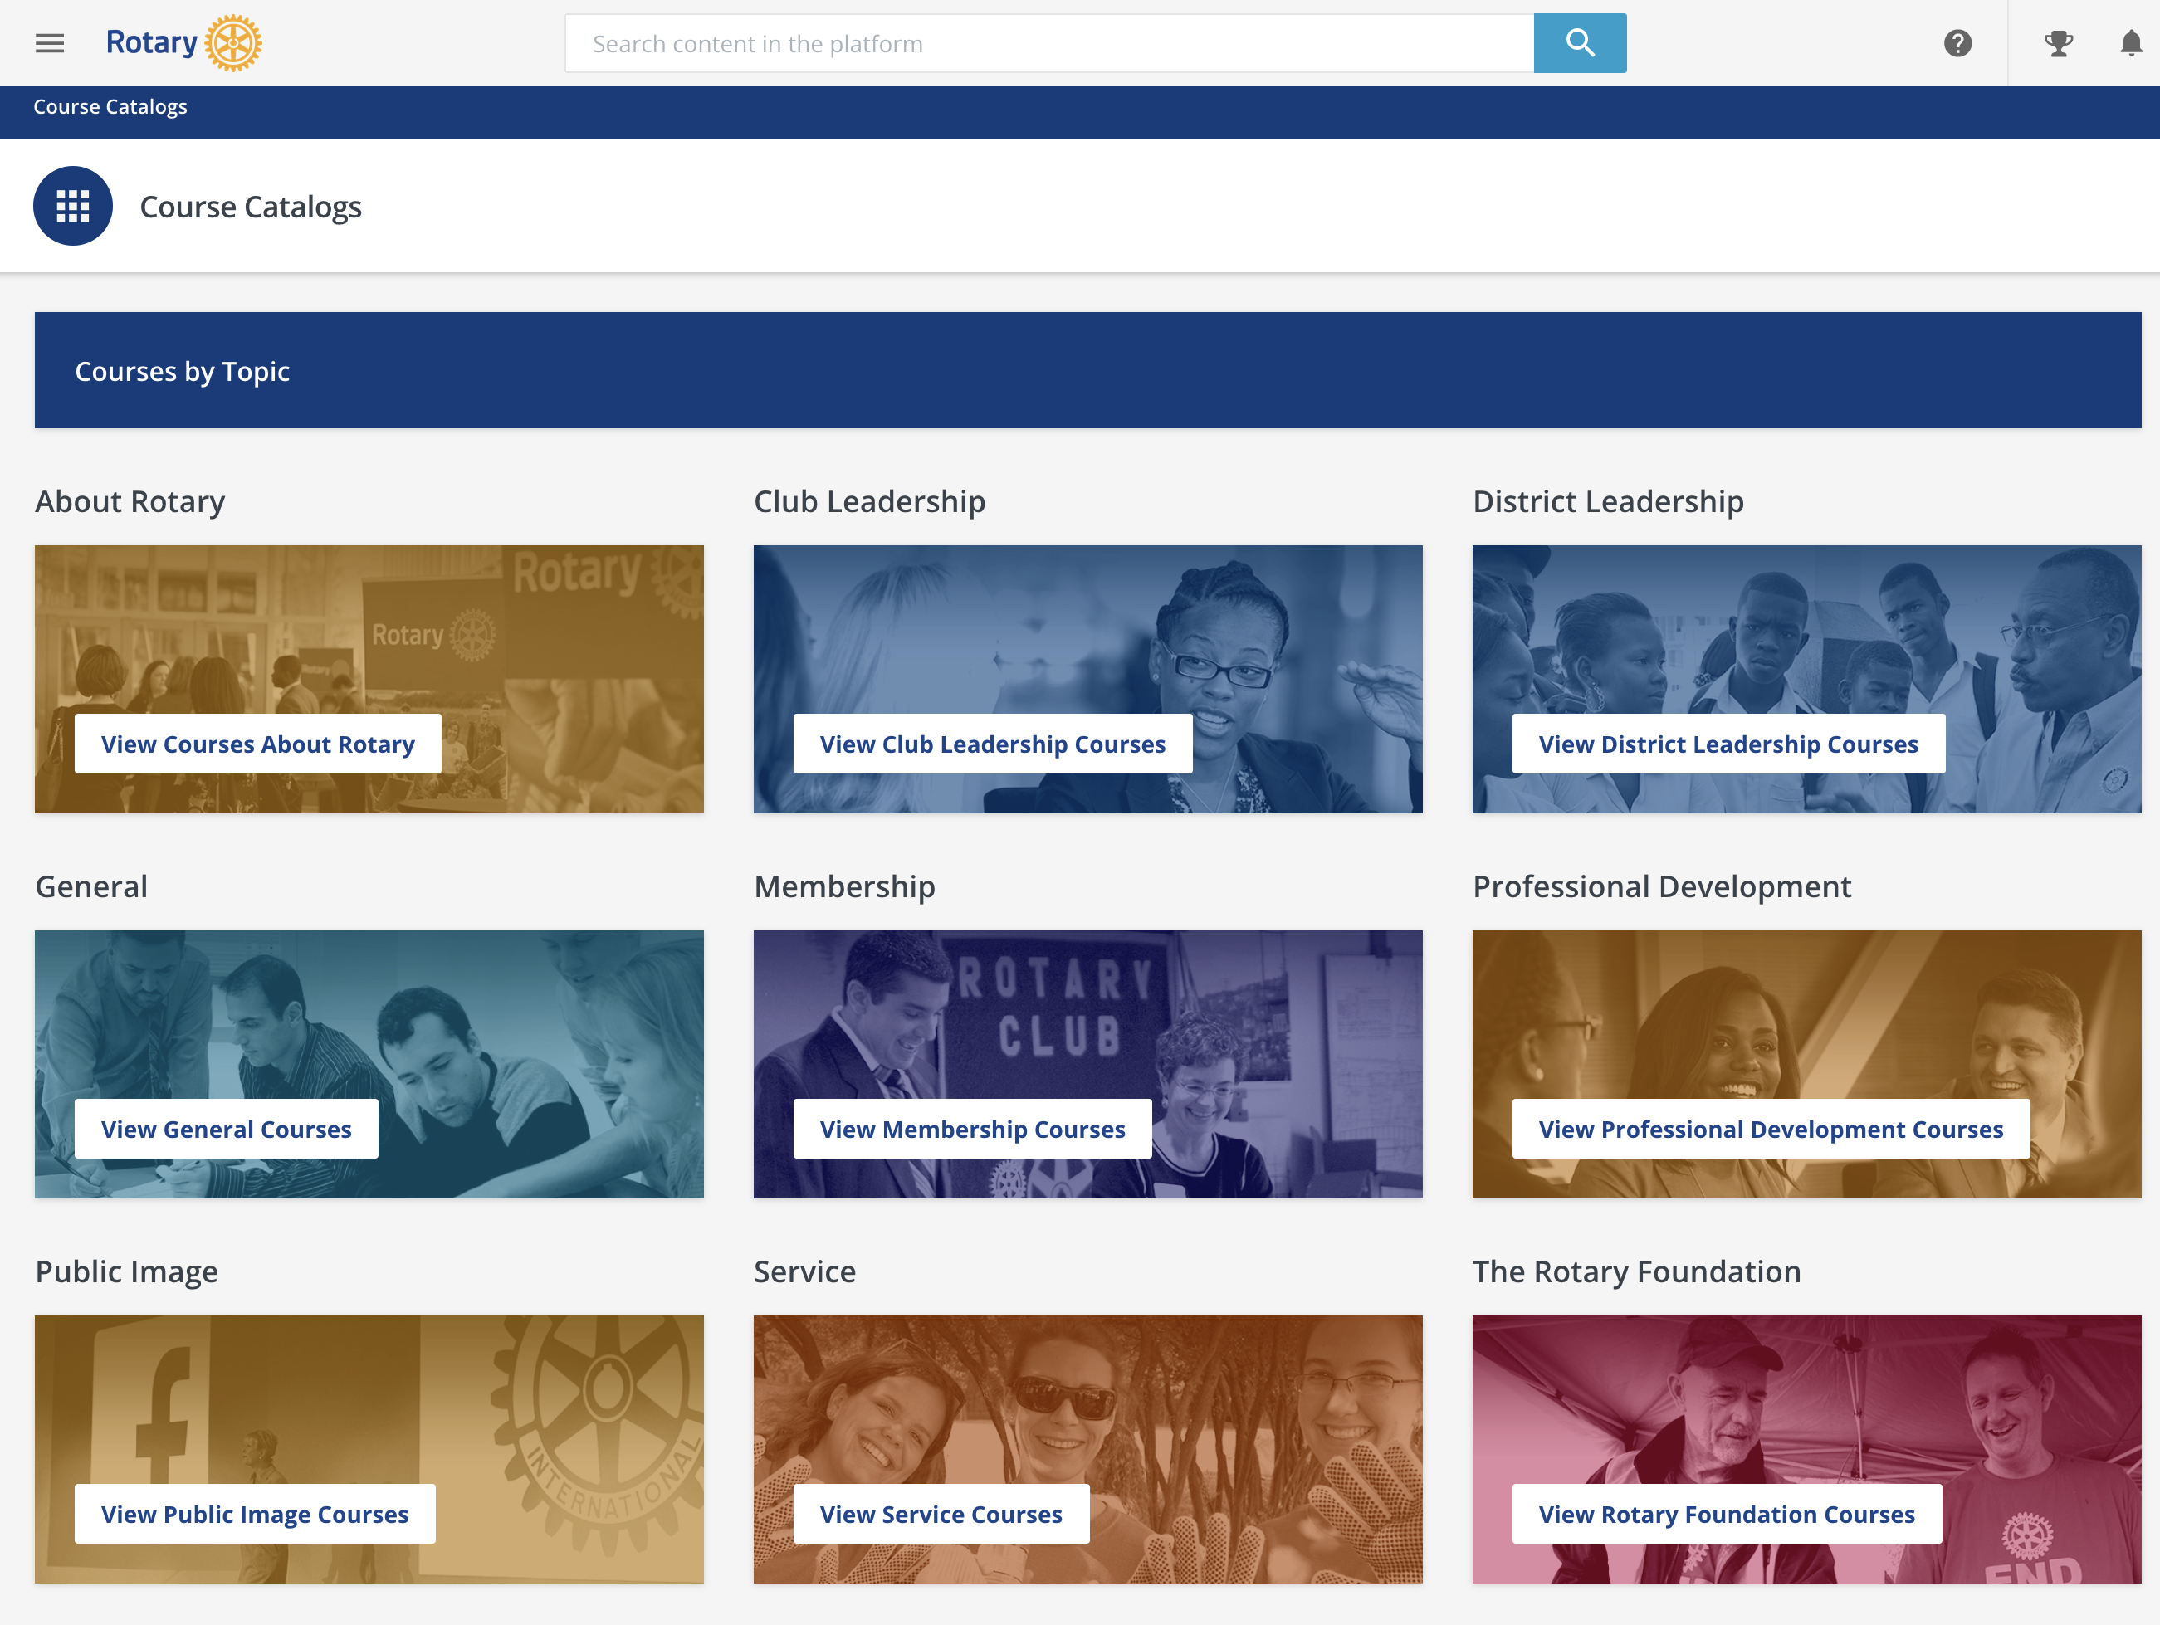

Slide 25
RESOURCES
The Learning Center
The Brand Center
Your public image team
Brand@rotary.org
Notes:
Here are resources that can help you with brand consistency.

Slide 26

QUESTIONS?
Notes:
Thank you for your time and attention. Does anyone have questions?

